Slide 1
PRINCIPLES OF GLOBAL ECONOMICS
Chapter 24: Measuring a Nation’s Income

Slide 2
Preview
Up to this point, we have been discussing individuals and markets.
Why do buyers and sellers behave in certain ways?
What determines prices and quantities in a market?
These questions fall under Microeconomics, the study of individual behavior.
Now we turn our attention to Macroeconomics, the study of the economy as a whole.
We begin by learning how economists measure total economic activity, which is essential for understanding growth, inflation, and unemployment.

Slide 3
The Measurement of GDP

Slide 4
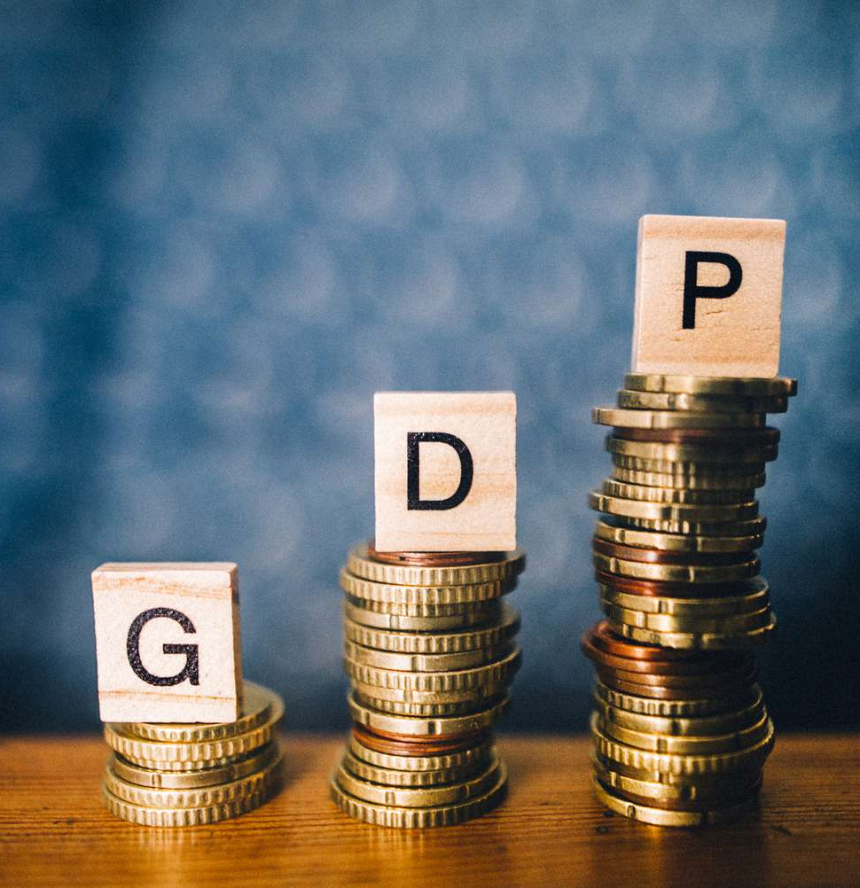
Gross Domestic Product
Before WW2, we relied on limited sample surveys such as sales in some grocery stores, to estimate the economic performance of a country.
Now, one of the most well-known measure of a country’s economic performance is Gross Domestic Product (GDP).
GDP measures two things at once:
GDP measures the total income of everyone in the economy.
GDP also measures the total expenditure on the economy’s output of goods and services.
Either way, the resulting number is identical.

Slide 5
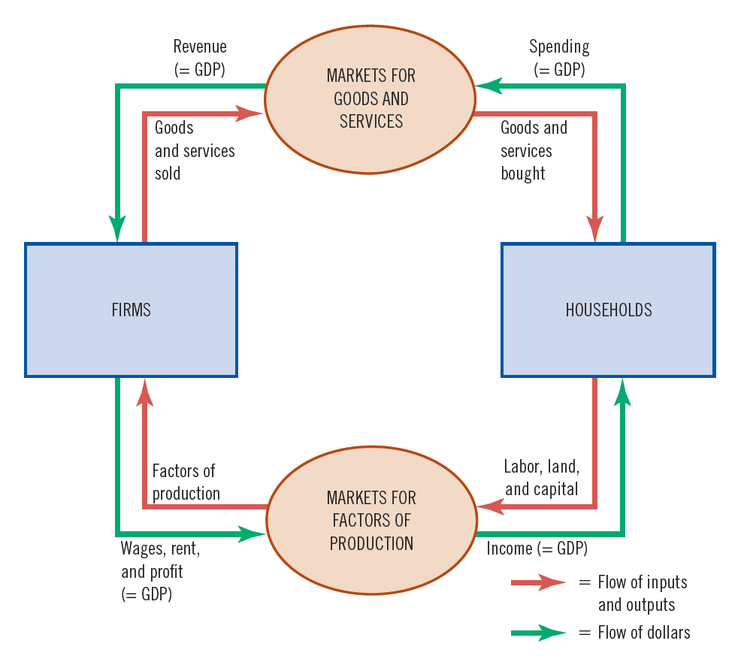
Gross Domestic Product
In theory, for an economy as a whole, income must equal expenditure:
Transactions have two parties: a buyer and a seller.
The amount paid by a buyer must equal the amount the seller receives.
The circular flow diagram illustrates this fact.
Households buy goods and services from firms.
Firms use revenue from sales for wages to workers, rent to landowners, and profit to owners.
GDP equals the total amount spent by households in the markets.
It also equals the total wages, rent, and profit paid by firms in the markets for the factors of production

Slide 6
Gross Domestic Product
Gross Domestic Product (GDP) is defined as
the market value of all final goods and services produced within a country over a given period.

Slide 7
Gross Domestic Product
Only goods and services traded in markets will be counted in GDP.
The value of underground or unreported economic activity is excluded.
The U.S. underground economy is estimated to be 10 to 12% of GDP, according to IRS estimates.
The value of home production is excluded.
In the U.S., unpaid household work is valued at roughly 25 to 30% of GDP.
Externalities are not included in GDP, since they are not traded in markets.
Environmental damages in the U.S. have been estimated at 3 to 5% of GDP.
Gross Domestic Product (GDP) is defined as the market value of
all final goods and services produced within a country over a given period.

Slide 8
Gross Domestic Product
GDP is a comprehensive measure of the production of tangible goods and intangible services but only measures the value of final goods and services.
Final vs. Intermediate:
Final Goods: Intended for the end user. (e.g., coffee beans sold to consumers)
Intermediate Goods: Used as inputs when producing other goods. (e.g., Coffee beans sold to Starbucks)
The value of final goods and services already includes the value of the intermediate goods used in production.
Gross Domestic Product (GDP) is defined as the market value of
all final goods and services produced within a country over a given period.

Slide 9
Gross Domestic Product
GDP counts goods and services that are newly produced.
Simple transactions where existing goods change hands, with no new production, are omitted from GDP.
Transfer payments such as subsidies and government aid (e.g., Social Security) are omitted from GDP.
Financial transactions such as buying stocks do not count as production and are not included in GDP.
The sale of an existing house is not included in GDP, because this is simply a transfer of ownership.
If a tenant pays rent to a landlord, that rent is counted in GDP under newly provided housing services.
Gross Domestic Product (GDP) is defined as the market value of
all final goods and services produced within a country over a given period.

Slide 10
Gross Domestic Product
GDP counts goods and services produced within the borders of a country regardless of the ownership structure.
A U.S. citizen’s production in Canada
…is not counted in U.S. GDP.
…is counted in Canadian GDP.
A Canadian citizen’s production in the US
…is counted in U.S. GDP.
…does not count toward Canada’s GDP.
Gross Domestic Product (GDP) is defined as the market value of
all final goods and services produced within a country over a given period.

Slide 11
Gross Domestic Product
GDP measures the value of production that takes place within a specific interval of time.
Typically, the interval is a year or a quarter (3 months).
When reporting quarterly figures, GDP is seasonally adjusted.
GDP measures the economy’s flow of expenditure during that interval.
Flow vs. Stock Variables:
Flow Variables: Quantities measured over a period of time. (e.g., GDP)
Stock Variables: Quantities measured at a particular point in time. (e.g., Money Supply)
Gross Domestic Product (GDP) is defined as the market value of
all final goods and services produced within a country over a given period.

Slide 12
Other Measures of National Income
Gross Domestic Income (GDI)
GDI is the total income earned by a country’s residents and businesses.
GDP and GDI are usually very similar but are often slightly different due to imperfect data.
The difference between GDP and GDI is called the statistical discrepancy.
Gross National Product (GNP)
GNP is the total income earned by a nation’s residents (nationals).
Includes income that domestic residents earn abroad.
Excludes income earned by foreigners within the country’s borders.
Net National Product (NNP)
NNP is GNP minus depreciation.
Depreciation is the wear and tear on the economy’s stock of equipment and structures.

Slide 13
Components of GDP

Slide 14
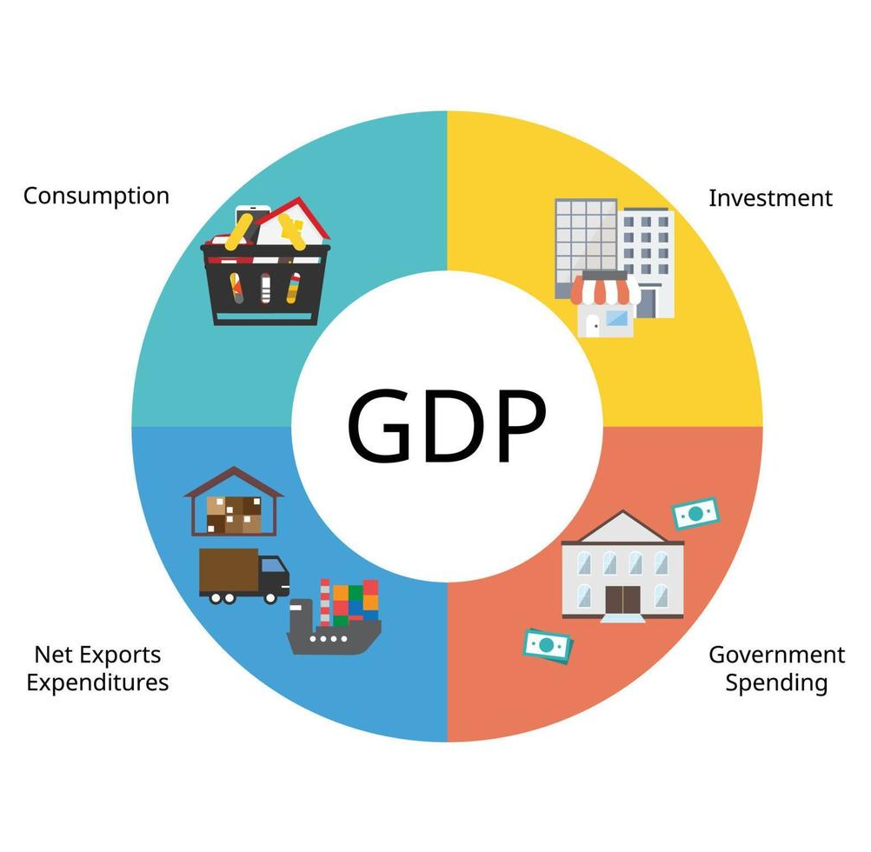
The Components of GDP
GDP (denoted Y) is divided into four components, each representing a different type of spending.
Consumption (C)
Investment (I)
Government Expenditure (G)
Net Exports (NX)
The sum of the four components equals GDP:
Y=C+I+G+NX

Slide 15

Consumption (C)
Consumption is spending by households on goods and services except for purchases of new housing.
Includes:
Durable Goods: Cars, household appliances, etc.
Nondurable Goods: Food, clothing, etc.
Intangible Items: Medical care, education, etc.
Excludes purchases of new housing but includes the (imputed) rental value of the house.
Consumption is the largest component of U.S. GDP, typically around 65 to 70%.

Slide 16

Investment (I)
Investment is the purchase of goods that will be used in the future to produce more goods and services, or Capital Goods.
Includes:
Business Capital: Factories, office buildings, intellectual property products, equipment, machinery, etc.
Residential Capital: Newly constructed residential housing.
Inventory: Goods produced but not yet sold.
Does not include financial investments.
Investment makes up a much smaller share of U.S. GDP than consumption, typically around 20%.

Slide 17

Government Expenditure (G)
Government Expenditure measures spending on goods and services by the federal, state, and local governments.
Includes:
Federal, state, and local spending on goods and services.
Salaries of government workers.
Expenditure on public works.
Does not include transfer payments such as Social Security payments or SNAP benefits.
Government Expenditure is a smaller component of U.S. GDP, typically around 17 to 18%.

Slide 18

Net Exports (NX)
Net exports equal the foreign purchases of domestically produced goods minus the domestic purchases of foreign goods.
In other words, NX=Exports-Imports.
A plus sign is placed in front of exports, since the goods are produced domestically.
A minus sign is placed in front of imports, since the goods are produced overseas.
GDP aims to measure the value of domestic production.
Net exports are a small component of U.S. GDP and are typically negative, around −3% of GDP.

Slide 19
Exercise: Economic Activity and GDP
What is the effect on U.S. GDP and its components if…
A consumer orders takeout food worth $25 from DoorDash?
C increases by $25 → GDP increases by $25
A consumer purchases a new laptop worth $2,000 that was produced in China?
C increases by $2,000, NX decreases by $2,000 → GDP is unchanged
A consumer purchases last year’s laptop worth $900 that was produced in the U.S.?
C increases by $900, I decreases by $900 → GDP is unchanged
A U.S. firm produces $100 million worth of PCs and sells $70 million worth that year?
C increases by $70 million, I increases by $30 million → GDP increases by $100 million

Slide 20
Real vs. Nominal GDP

Slide 21


Nominal vs. Real
The highest-grossing film of all time is said to be Avatar (2009), with a worldwide box-office gross of approximately $2.9 billion.
Adjusted for inflation, the highest-grossing film of all time is Gone with the Wind (1939).
Inflation-adjusted (2024) box-office gross of $4.4 billion.
Avatar’s inflation-adjusted box-office gross is $4 billion.
The highest-grossing film of all time is Avatar in nominal terms, but Gone with the Wind in real terms:
Nominal refers to “value in current monetary terms.”
Real refers to “value adjusted for inflation to reflect its actual purchasing power.”

Slide 22
Nominal vs. Real GDP
Nominal GDP is calculated using current year’s prices and current year’s production:
Real GDP is calculated using a base year’s prices and current year’s production:
Nominal GDP can increase for two reasons:
The output of the economy grows (Q increases)
The price level of the economy increases (P increases)
We want a measure of the total quantity of goods and services the economy is producing, independent of changes in the prices of those goods and services.
Nominal GDP = (Current Prices) $×$ (Current Quantity) = ${\text{P}}_{\text{current}}×{\text{Q}}_{\text{current}}$
Real GDP = (Base Year’s Prices) $×$ (Current Quantity) = ${\text{P}}_{\text{base}}×{\text{Q}}_{\text{current}}$

Slide 23
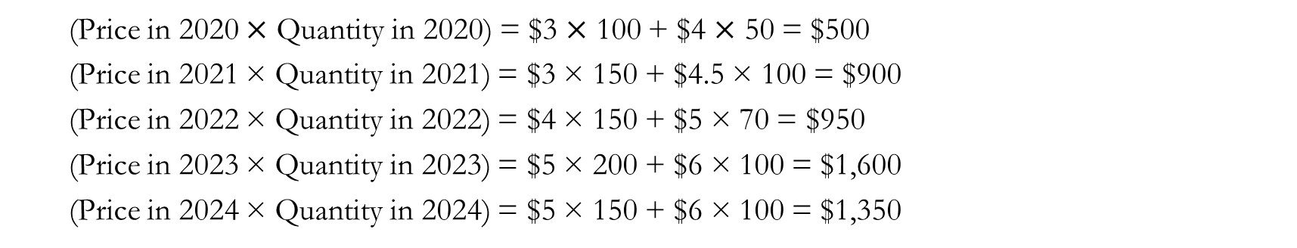
Exercise: Nominal vs. Real GDP
Consider an economy that exclusively produces coffee and donuts:
Calculate the nominal GDP:
2020:
2021:
2022:
2023:
2024:
Year | Price (Coffee) | Price (Donuts) | Units (Coffee) | Units (Donuts)
2020 | $3 | $4 | 100 | 50
2021 | $3 | $4.5 | 150 | 100
2022 | $4 | $5 | 150 | 70
2023 | $5 | $6 | 200 | 100
2024 | $5 | $6 | 150 | 100
(Price in 2020 $×$ Quantity in 2020) = $3 $×$ 100 + $4 $×$ 50 = $500
(Price in 2021 × Quantity in 2021) = $3 × 150 + $4.5 × 100 = $900
(Price in 2022 × Quantity in 2022) = $4 × 150 + $5 × 70 = $950
(Price in 2023 × Quantity in 2023) = $5 × 200 + $6 × 100 = $1,600
(Price in 2024 × Quantity in 2024) = $5 × 150 + $6 × 100 = $1,350

Slide 24
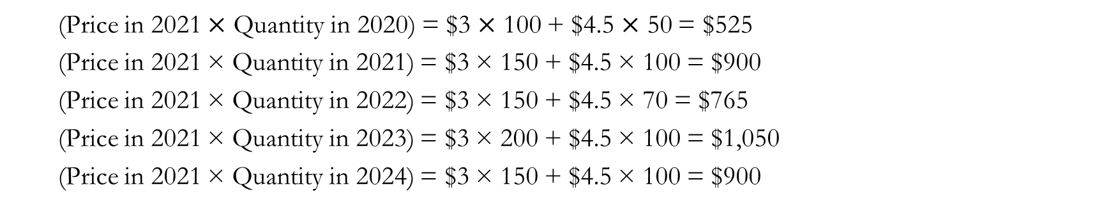
Exercise: Nominal vs. Real GDP
Consider an economy that exclusively produces coffee and donuts:
Calculate the real GDP with 2021 as the base year:
2020:
2021:
2022:
2023:
2024:
Year | Price (Coffee) | Price (Donuts) | Units (Coffee) | Units (Donuts)
2020 | $3 | $4 | 100 | 50
2021 | $3 | $4.5 | 150 | 100
2022 | $4 | $5 | 150 | 70
2023 | $5 | $6 | 200 | 100
2024 | $5 | $6 | 150 | 100
(Price in 2021 $×$ Quantity in 2020) = $3 $×$ 100 + $4.5 $×$ 50 = $525
(Price in 2021 × Quantity in 2021) = $3 × 150 + $4.5 × 100 = $900
(Price in 2021 × Quantity in 2022) = $3 × 150 + $4.5 × 70 = $765
(Price in 2021 × Quantity in 2023) = $3 × 200 + $4.5 × 100 = $1,050
(Price in 2021 × Quantity in 2024) = $3 × 150 + $4.5 × 100 = $900

Slide 25
Exercise: Nominal vs. Real GDP
With 2021 as the base year, we can summarize our findings as:
We find a potential issue with relying on nominal GDP alone:
The economy’s actual output between 2021 and 2024 remains constant at 150 cups of coffee and 100 donuts.
Yet nominal GDP increases from $900 to $1,350 purely due to rising prices of coffee and donuts.
Real GDP remains constant at $900, reflecting the fact that, once we account for inflation, the economy did not grow.
Year | Price (Coffee) | Price (Donut) | Units (Coffee) | Units (Donut) | Nominal GDP | Real GDP
2020 | $3 | $4 | 100 | 50 | $500 | $525
2021 | $3 | $4.5 | 150 | 100 | $900 | $900
2022 | $4 | $5 | 150 | 70 | $950 | $765
2023 | $5 | $6 | 200 | 100 | $1,600 | $1,050
2024 | $5 | $6 | 150 | 100 | $1,350 | $900

Slide 26
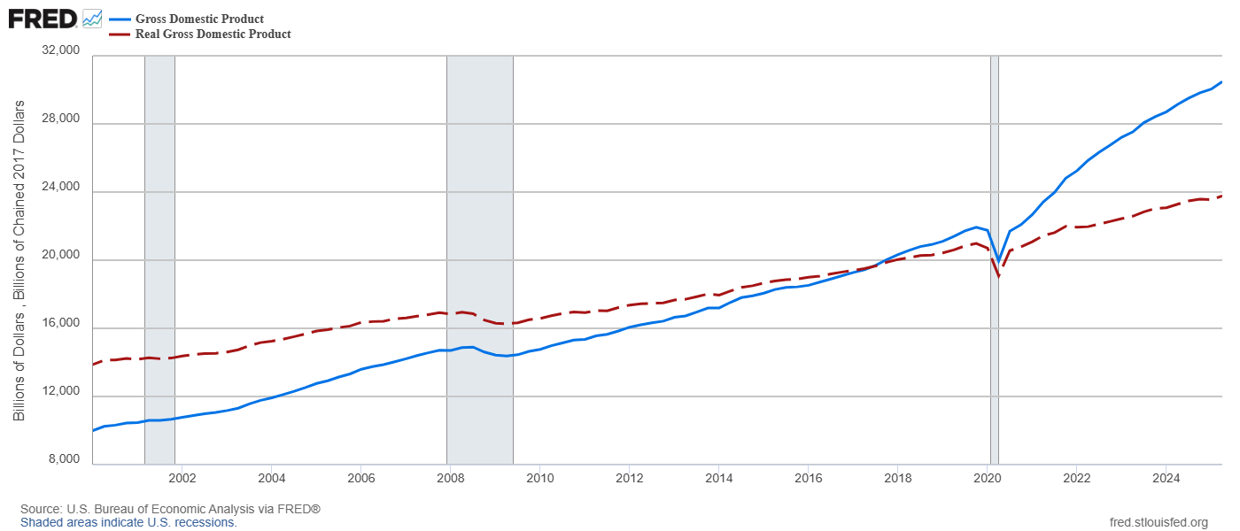
Nominal vs. Real GDP

Slide 27
Detour: GDP Deflator
The GDP deflator is a measure of the price level, calculated as the ratio of nominal GDP to real GDP times 100.
The GDP deflator measures the current price level relative to the price level in the base year.
A GDP deflator of 120 means prices are 20 percent higher than in the base year.
It gets its name because it “deflates” nominal GDP for the portion that is due to price increases.
The GDP deflator is one measure of inflation, the increase in the overall price level in the economy, which we will discuss in more detail in the next chapter.
GDP Deflator = $\frac{\text{Nominal} \text{GDP}}{\text{Real} \text{GDP}}×\text{100}$

Slide 28
GDP and Well-Being

Slide 29

GDP as a Measure of Well-Being?
GDP measures the economic output of a country, but we often use it as a proxy measure for the well-being of the economy’s constituents.
Often, we use real GDP per capita as the main indicator as the average person’s standard of living in a given country.
Real: Accounting for fluctuations in purchasing power.
Per Capita: Accounting for population differences.
But GDP is not a perfect measure of well-being in a society.

Slide 30

Wimble Don (2018, June 1). Robert Kennedy on GDP [Video]. YouTube. https://youtu.be/3FAmr1la6w0?si=mivWAALf42tGCc_y

Slide 31
GDP as a Measure of Well-Being
GDP omits many important aspects that contribute to human well-being.
GDP does not capture any activity not traded in the market.
GDP omits externalities that may exist in the market.
GDP does not take income distribution into consideration.
GDP does not measure economic mobility.
We still measure GDP because, although it is imperfect, a larger GDP provides a country with greater capacity to ensure a better life for its citizens.
While GDP does not measure the quality of education, countries with a higher GDP can allocate more funds to their public education systems.
While GDP does not measure environmental quality, countries with a higher GDP can allocate more resources toward environmental protection.
Many indicators of the quality of life are positively correlated with GDP.

Slide 32
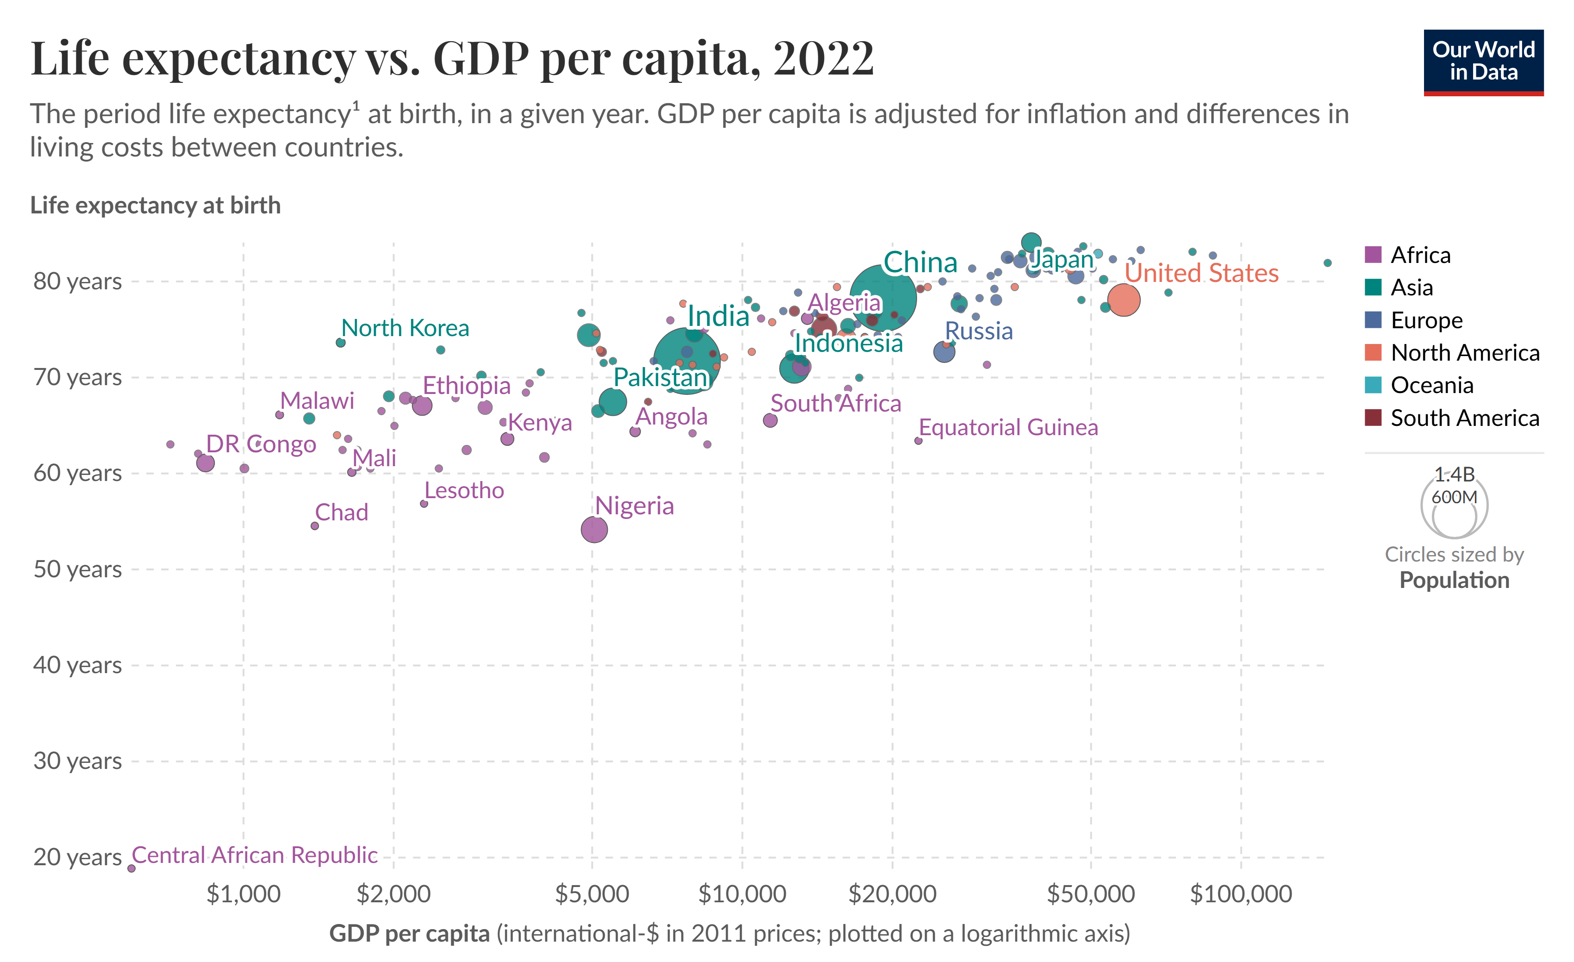
GDP and Life Expectancy

Slide 33
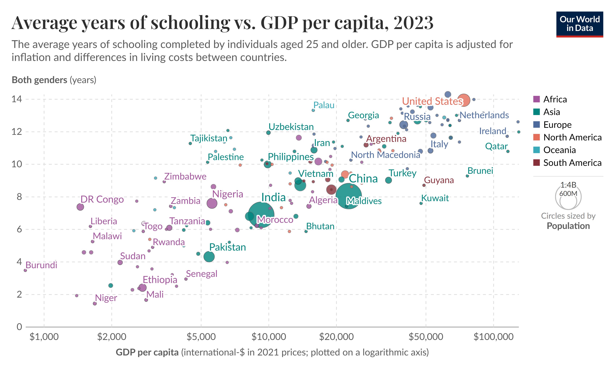
GDP and Education

Slide 34
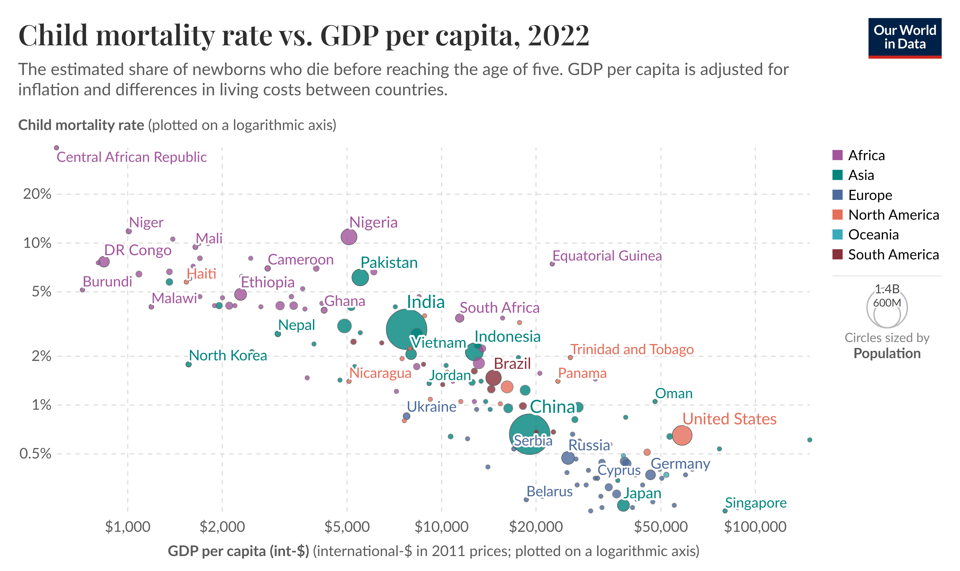
GDP and Child Mortality

Slide 35
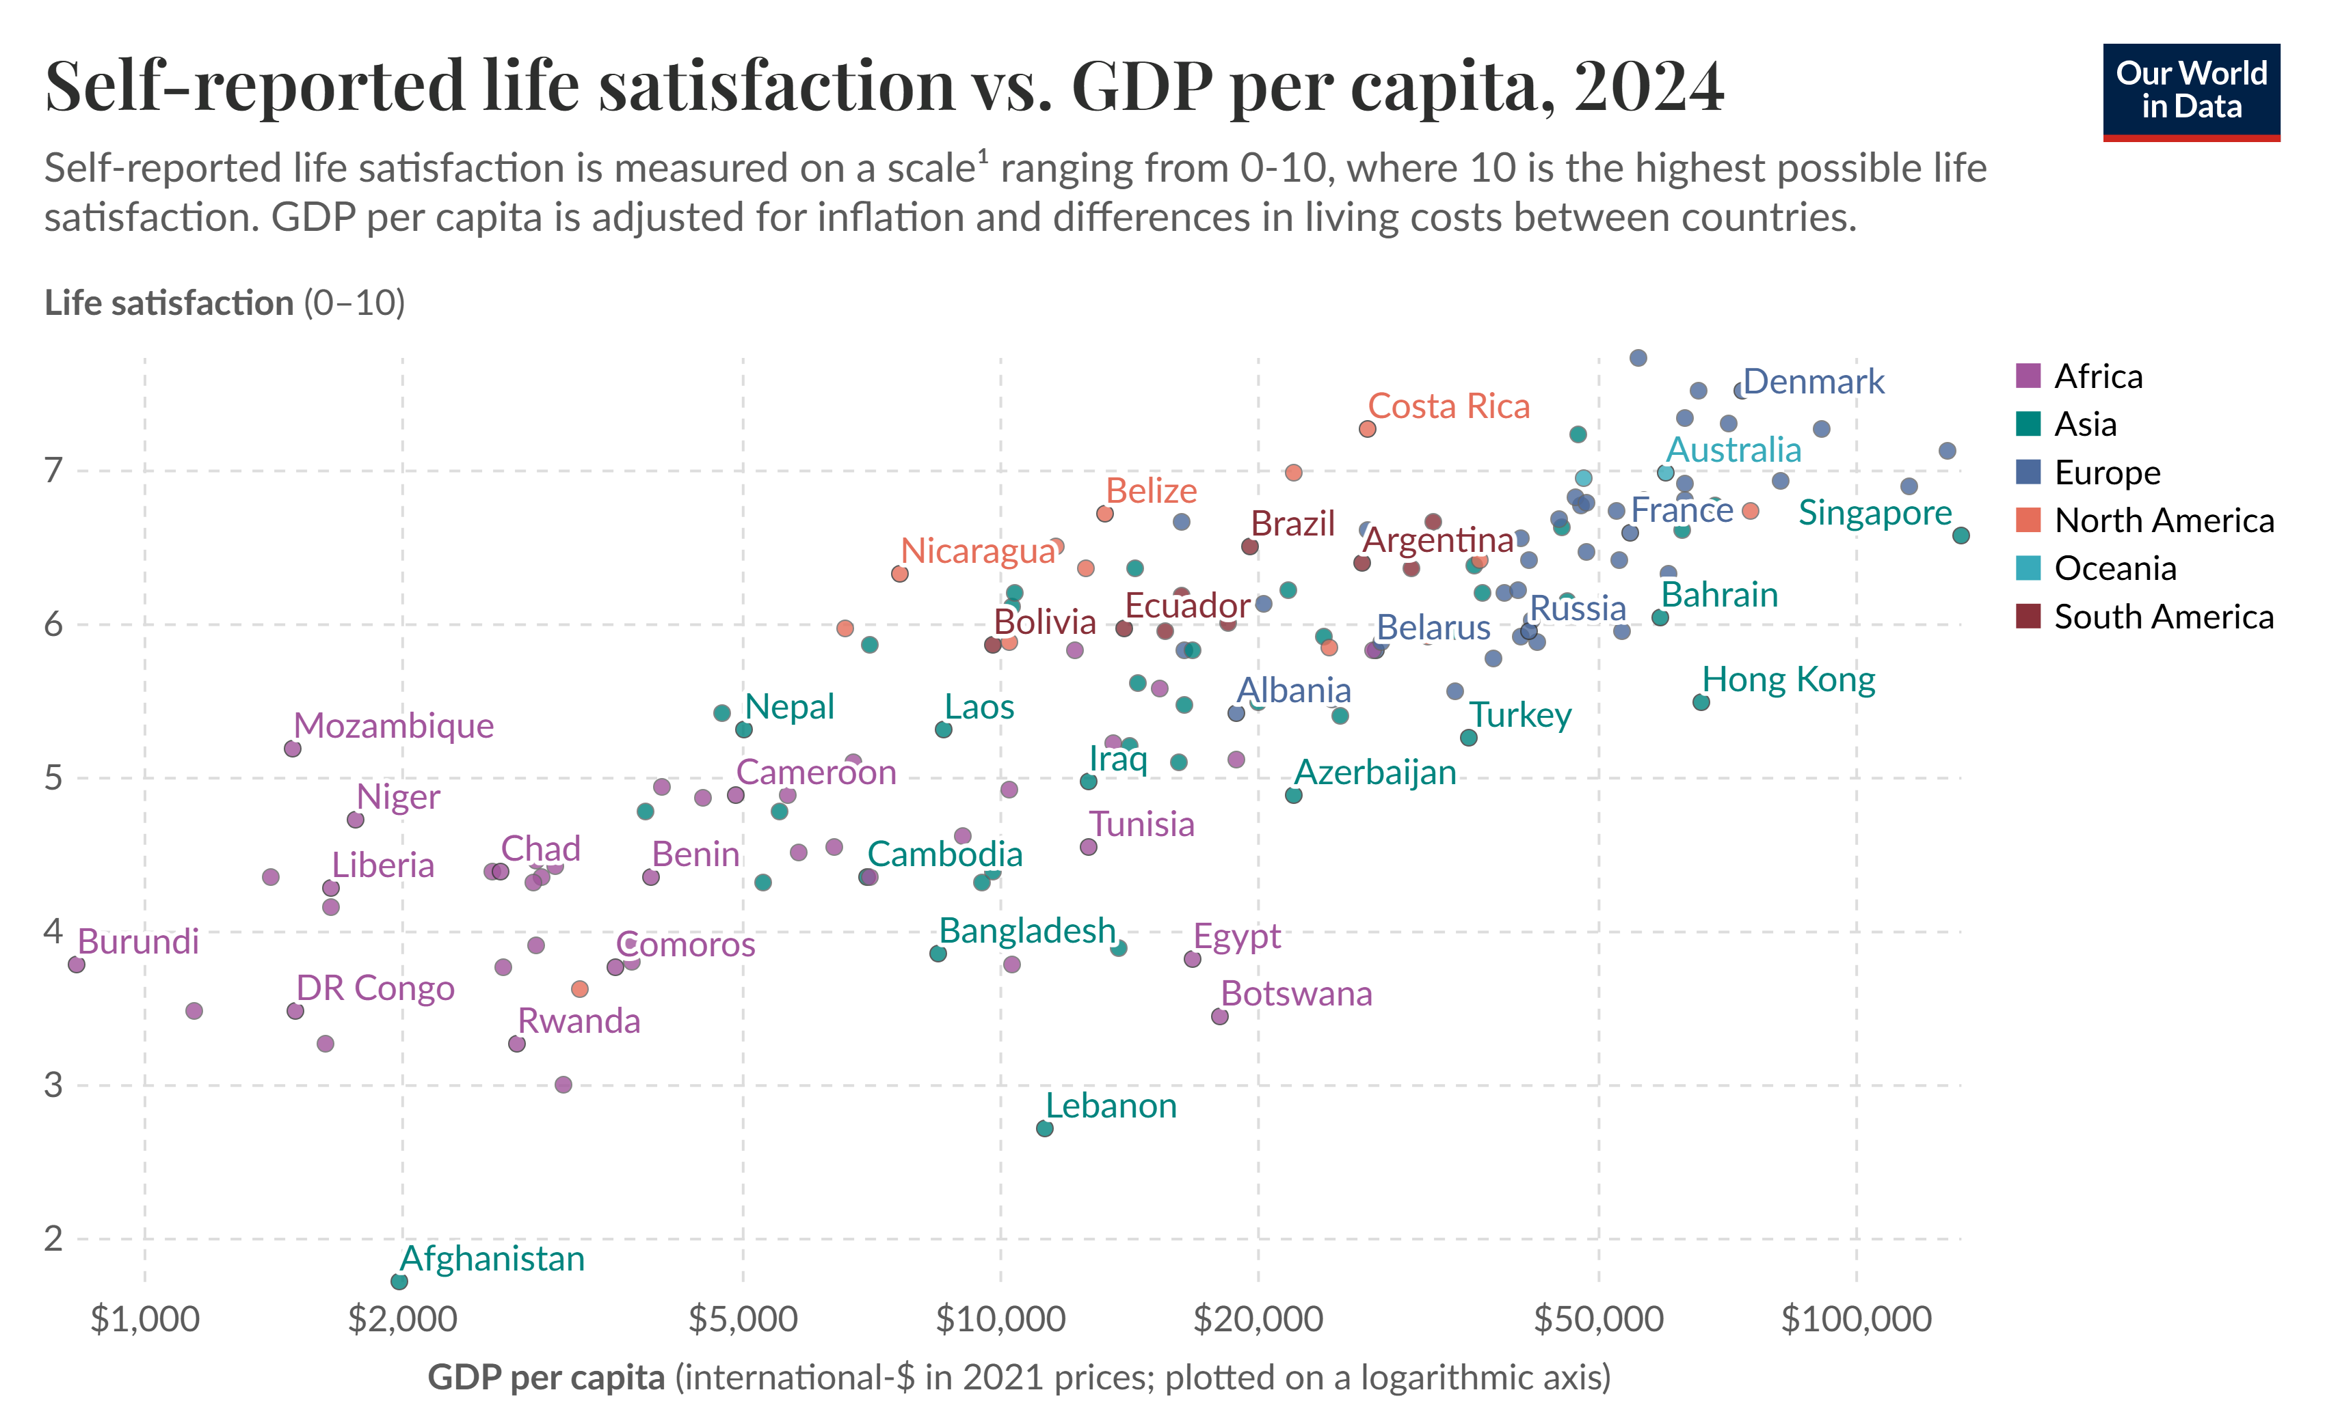
GDP and Life Satisfaction

Slide 36
Recap of Chapter 24

Slide 37
Recap
GDP measures the market value of all final goods and services produced within a country in a given period.
The four components of GDP are Consumption, Investment, Government Expenditure, and Net Exports.
Nominal GDP uses current prices while real GDP uses constant base-year prices.
The GDP deflator measures changes in the price level.
Real GDP per capita is commonly used as a proxy for standard of living.
GDP is a useful but imperfect measure of well-being.

